Slide 1

DeepSeek-V3 to DeepSeek-V4
A Technical and Architectural Comparison
Faculty of Computer Science
Moscow 2026

Slide 2
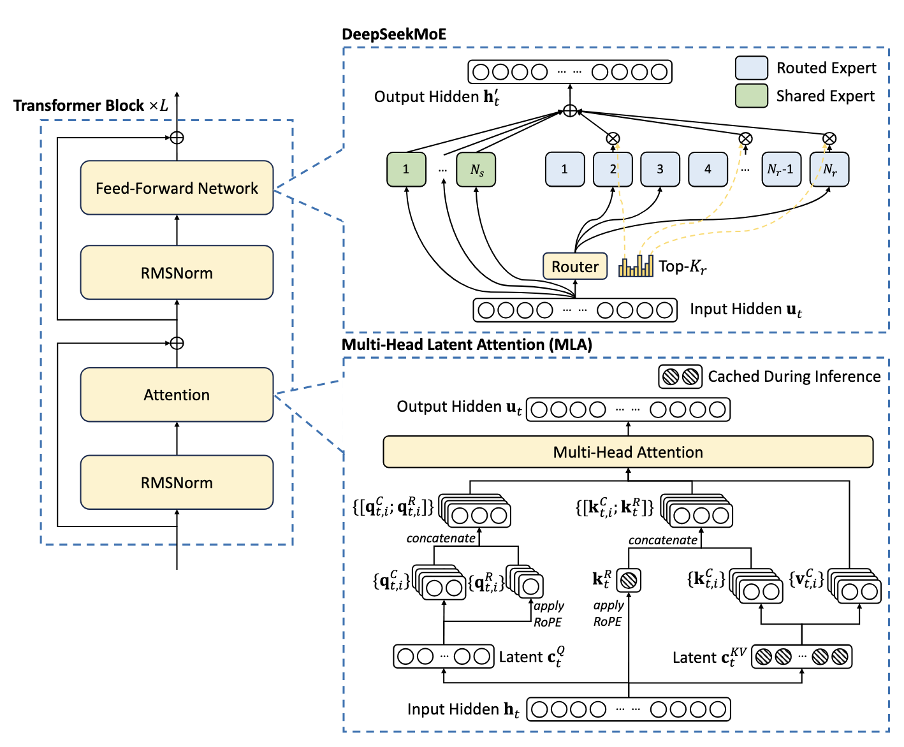
DeepSeek-V3 - the baseline to compare against
MLA + DeepSeekMoE: compact KV state, sparse experts, 128K context
671B
37B
61
128K
14.8T
total params
activated / token
Transformer layers
context window
pre-training tokens
WHY IT MATTERS
•
MLA caches a low-rank latent rather than full per-head K/V.
DeepSeekMoE uses 1 shared + 256 routed experts; 8 routed experts are activated per token.
•
The model reaches 128K through post-training context extension; pre-training itself uses max 4K sequences.
•

Slide 3
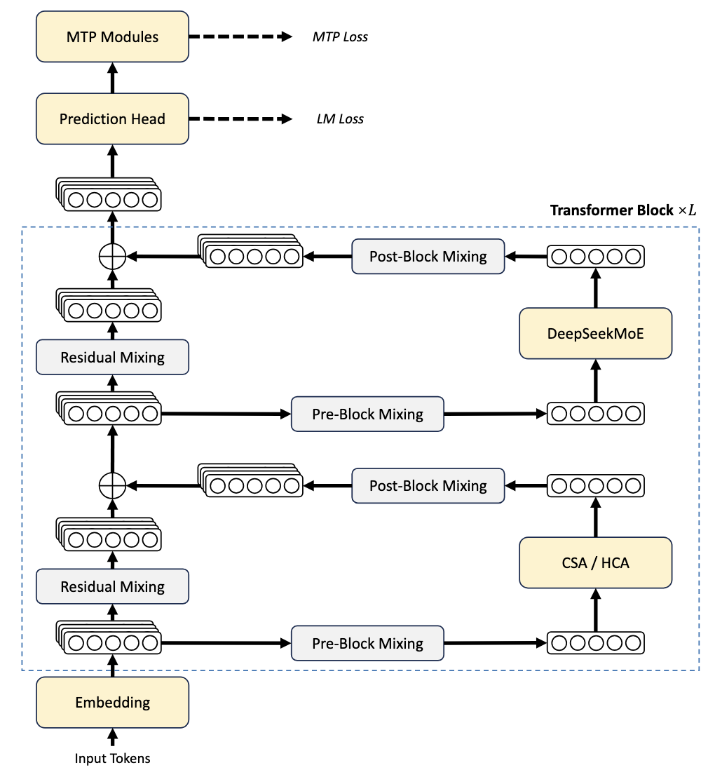
DeepSeek-V4 - same Transformer family, different efficiency path
Hybrid CSA/HCA + mHC + Muon; V4-Pro and V4-Flash both target 1M context
1.6T
49B
284B
13B
1M
V4-Pro total
V4-Pro active
V4-Flash total
V4-Flash active
context
THREE ARCHITECTURAL UPGRADES
Attention: MLA → hybrid Compressed Sparse Attention (CSA) + Heavily Compressed Attention (HCA).
•
•
Residual path: standard residual connections → manifold-constrained Hyper-Connections (mHC).
Training: AdamW → Muon for most parameters; context curriculum reaches 1M and activates sparsity from 64K.
•

Slide 4
What actually changed?
Focus on architectural and training mechanisms; MTP stays essentially unchanged.
Component
DeepSeek-V3
DeepSeek-V4
Teaching point
Attention
MLA; dense MHA
Hybrid CSA + HCA; shared-KV MQA
V4 cuts both KV entries and attended entries.
KV organization
Low-rank latent per token
4× block compression + 128× heavy compression + local window
Compression becomes sequence-level.
Residual path
Standard residual connections
mHC; 4× residual width in V4 configs
More expressive residual mixing, explicitly stabilized.
MoE routing
1 shared + 256 routed; Top-8
1 shared + 384 routed in Pro; Top-6; Sqrt(Softplus)
Paradigm retained; routing/system details changed.
Optimizer
AdamW
Muon for most matrices; AdamW exceptions
Optimizer is co-designed with the new architecture.
Context training
4K pretrain → post-training 32K → 128K
4K → 16K → 64K → 1M; sparsity after 64K
Long context is trained, not only extrapolated.
MTP
Depth 1
Depth 1; configuration retained
Not a V4 architectural change.
Core shift: V3 optimizes the representation of KV; V4 also optimizes how many KV states each query ever needs to attend.

Slide 5





The biggest change: MLA → hybrid CSA + HCA
V4 attacks long-context attention with compression first, then sparse or dense attention on the compressed sequence.
V3 · MLA
V4 · CSA + HCA
Per-token latent compression
Two complementary attention paths
$$h_{t}$$
$$W^{DKV}$$
$$c_{t}^{KV}$$
N hidden states
CSA: m=4
Top-k DSA
Up-project K,V
N / 4 compressed entries
Dense MHA
N hidden states
HCA: $m^{′}$ 128 =
Dense MQA
Inference cache
$$\left[c_{t}^{KV}, K_{t}^{R}\right]$$
N / 128 compressed entries
Sequence length is still $N$.
local sliding window + compressed global context

Slide 6
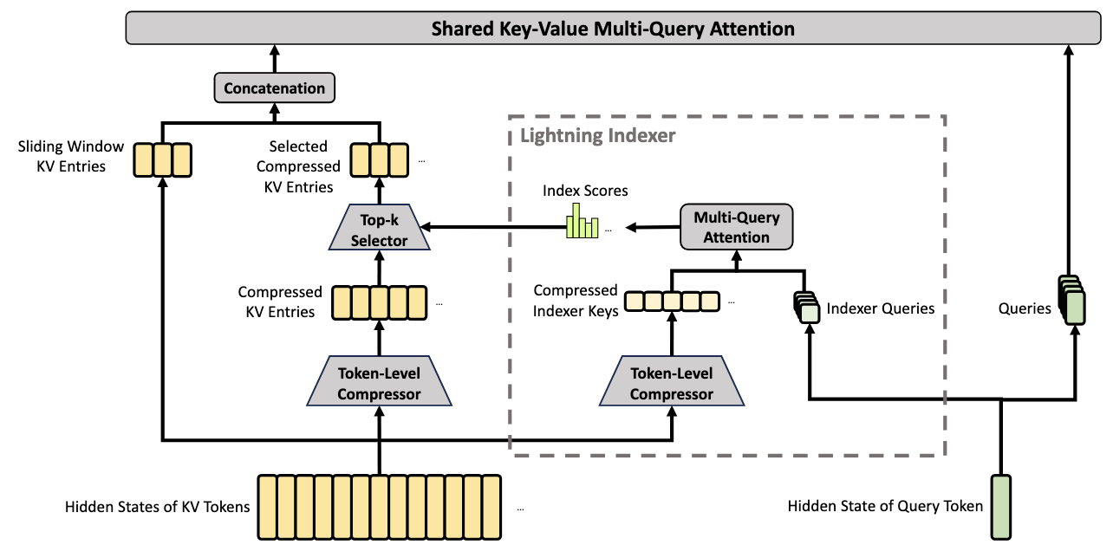
CSA in detail: compress → index → select → attend
This is the main long-range path: reduce KV entries first, then spend sparse attention only where needed.
V4-PRO CONFIG
m = 4
4 original KV positions → 1 compressed entry
Top-k = 1024
selected compressed entries per query
window = 128
recent KV entries kept for local detail
Conceptual sequence: N → N/4 → sparse top-k

Slide 7
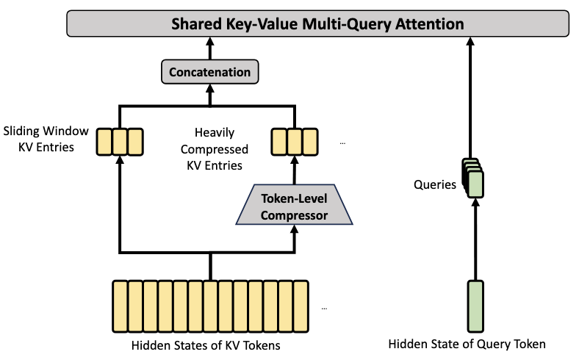

HCA: the second attention path
HCA goes further: extremely compress the sequence and then use dense attention because the compressed sequence is already tiny.
WHY KEEP BOTH?
CSA
m = 4
compress + sparse
preserve fine-grained long-range retrieval
HCA
$m^{′}$ = 128
compress + dense
very cheap global mixing
Window
128 tokens
uncompressed local
recency / exact local dependencies
Hybrid = allocate different attention roles across layers

Slide 8
KV cache and FLOPs: the quantitative payoff
The V4 paper reports its headline long-context efficiency numbers against DeepSeek-V3.2 - not the original V3.
REPORTED AT 1M CONTEXT
WHY THE CACHE SHRINKS
% of V3.2 baseline (lower is better)
27.0%
MLA already stores a compact latent state. V4 additionally reduces the number of stored KV entries with m = 4 / 128.
V4-Pro · FLOPs
•
≈ 3.7× lower
V4-Pro · KV cache
10.0%
CSA selects only top-k compressed entries for core attention; HCA uses dense attention on an extremely short compressed sequence.
≈ 9.5× smaller
•
V4-Flash · FLOPs
10.2%
The 1M-context claim is therefore an architectural + systems result, not simply a larger position-embedding limit.
≈ 9.8× lower
•
V4-Flash · KV cache
7.3%
≈ 13.7× smaller
Comparison baseline in the paper: V3.2

Slide 9
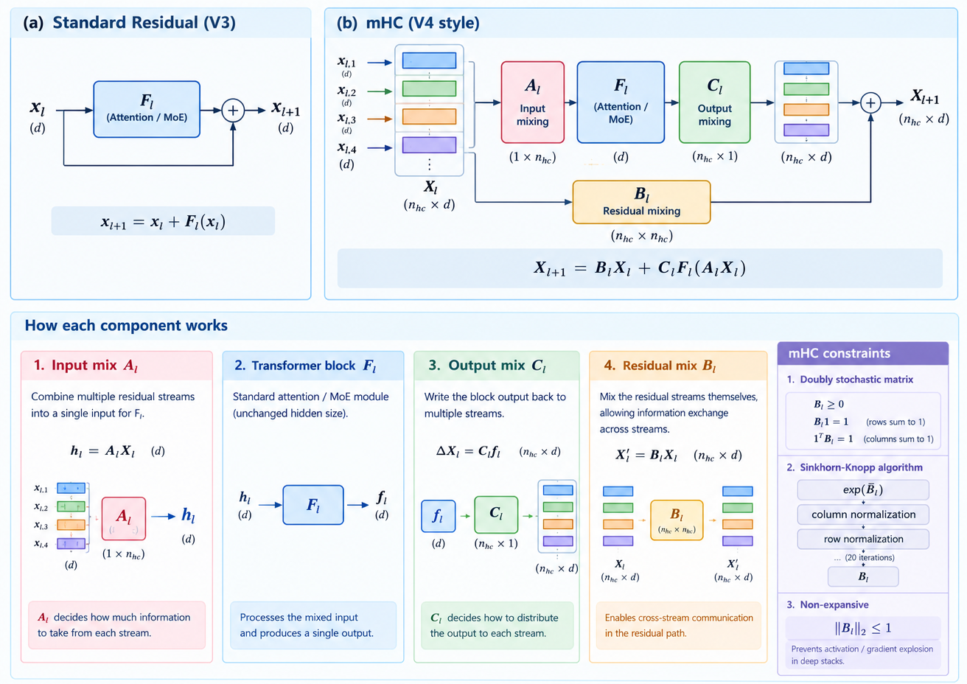
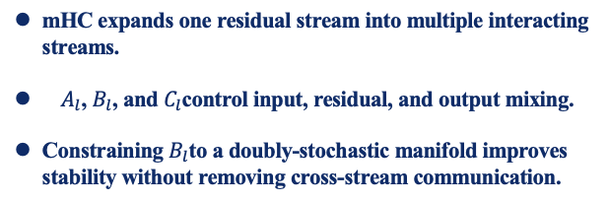
mHC: Stable Multi-Stream Residual Connections
Expanding the residual stream while constraining cross-stream mixing
More residual capacity and richer information flow - without sacrificing numerical stability.
mHC expands one residual stream into multiple interacting streams.
$A_{l}$, $B_{l}$, and $C_{l}$control input, residual, and output mixing.
Constraining $B_{l}$to a doubly-stochastic manifold improves stability without removing cross-stream communication.

Slide 10
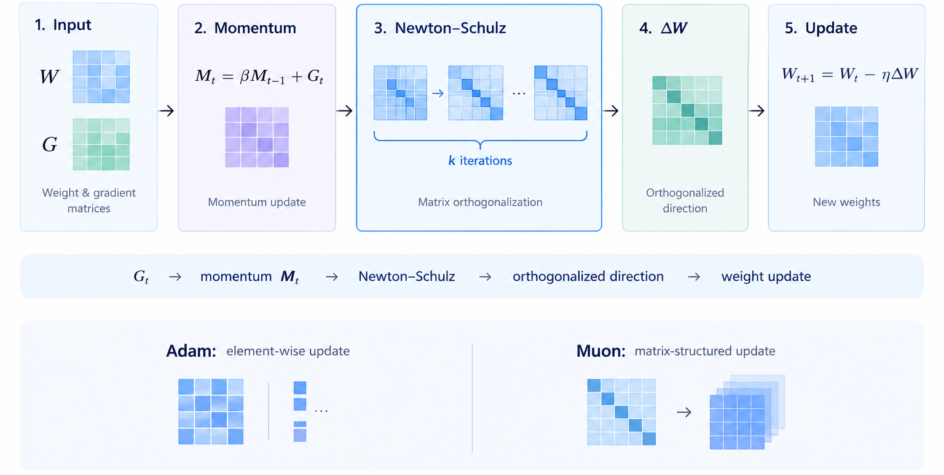
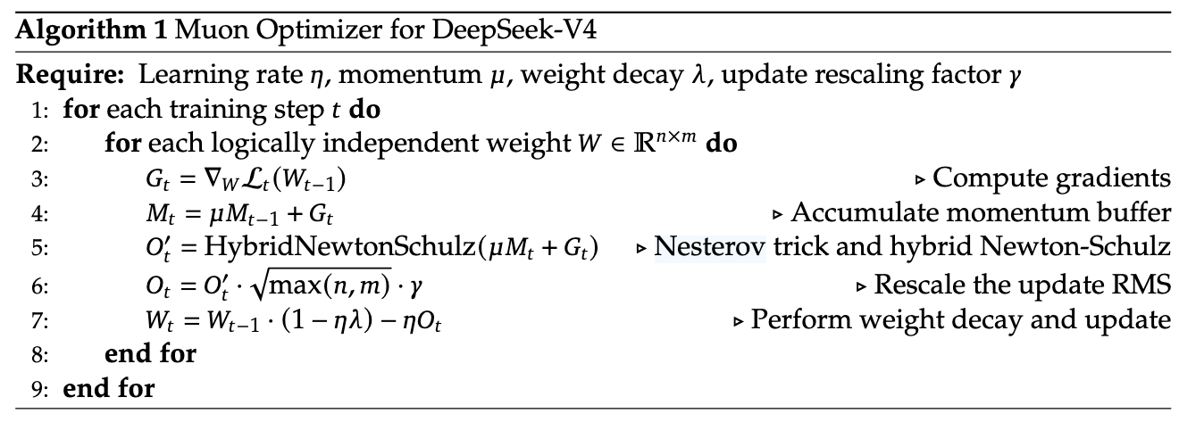
Muon: A New Optimizer for Large-Scale Training
From AdamW-style adaptive updates to matrix-structured optimization.
DeepSeek-V4 uses Muon for most matrix parameters, while retaining AdamW for selected parameter groups.
Momentum: accumulates the gradient signal.
Orthogonalization: Newton–Schulz approximately removes uneven singular-value scaling while preserving the matrix direction.
Update: the resulting structured matrix direction is used to update the weights.

